Slide 1

Social Network Analysis (SNA) for Modeling and Tuning an Online Social Media, Combating Terrorism Community
Edward B. Rockower (MOVES)
Sean F. Everton (Defense Analysis Dept.)
MOVES Research and Education Summit 2011
Session 1
12 July 2011
Ph: 831-402-4881
Email: ebrockow@nps.edu
http://movesinstitute.org

Slide 2
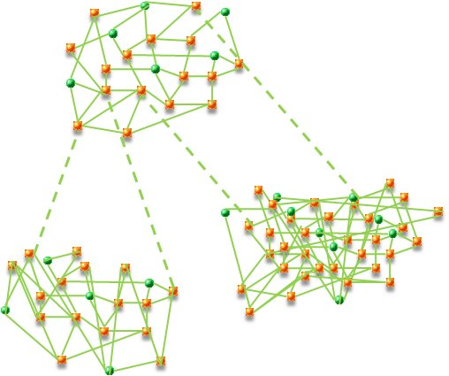
Agenda
Introduction & Disclaimer
Global Community of Combating Terrorism (CT) Professionals
Social Media Websites
Social Network Analysis (SNA) + Feedback
The “Plan”
Potential Outcomes
“If I had 8 hours to cut down a tree, I’d spend 6 hours sharpening my saw”
-- Abraham Lincoln
Notes:
We assume: access to web server logs and MySQL DB tables, a tool to xform to Network Data, a tool to calculate metrics (site and SNA), a tool for optimizing the SNA/website model, and the ability to feedback to the site the changes in the “decision variables” (tuning knobs of optimization).

Slide 3

Interdisciplinary War on Terror
Social Network Analysis: The study of network representations of social interactions
Web 2.0, Social Media, User-generated content, Distance Learning, Virtual Classrooms, games, multi-media, …
Establish, sustain a global network of CT experts & practitioners
Web-delivered knowledge management and collaboration platform
Significantly extend our reach to international communities
Support sustained global CT partnerships
“The greatest challenge to any thinker is stating the problem in a way that will allow a solution
-- Bertrand Russell
Notes:
Dark Web: the Terrorists and criminals use the internet effectively… how to interdict, how to find, how to avoid our networks being compromised

Slide 4
Global Combating Terrorism (CT) Challenge
A Program for Planning Future Directions for Analysis, Modeling, and Feedback, in its initial planning.
How to foster collaborations among ‘neighborhoods’ of CT professionals
  diverse international cultures and organizations.
How to measure cohesiveness within the global CT community
  from behavior on a social media website
How to encourage formation of
  bridging ties and tight-knit clusters
Notes:
Assume: (organic, agile, responsive, no pre-set “use cases”, but watch what works, and what doesn’t work)
Nascent, but working, dynamic Prof’l Social Media site for CT Prof’ls
access to server logs, DB fields
Transformm tool to network structure

Slide 5
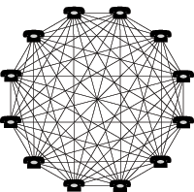
Measures of Effectiveness for
CTFP* Continuing Engagement
Existing Capital Investment
Keeping Connected
Cost per interaction is dramatically reduced
e.g. If ~ 20 - 80% use CTFP-ECCO*
➔ ~ $200 - $900 per user/yr
(for ~3,000 to 13,000 Alumni continually)
~$200 Million ➔ ~20,000 Alumni
~$10 K in-class cost per Fellow
~$5 K per in-person Continuing Engagement
(for only ~ 400 Alumni/year)
Extending the Reach: Metrics
“Network Effect”
% of all CTFP graduates in our database
% of all graduates using the CTFP ECCO website
% of new graduates regularly using ECCO
% of the total set of countries using website
Number of and growth in connectivity of sub-networks of Alumni interacting on the website
Reduced numbers of disjoint networks having low connectivity
increased number of bridging links between relatively homogeneous sub-networks of users (inter-agency or inter-nation)
Metric: speed at which the website 'scales up' to a critical mass
Metric: Value of a network >= N²
(but too simplistic)
* CTFP = Combating Terrorism Fellowship Program, ECCO = Education and Collaboration Community Online
Notes:
Assistant Secretary of Defense for Special Operations/Low Intensity Conflict and
Interdependent Capabilities (SO/LIC&IC) provides policy oversight. The Defense Security
Cooperation Agency (DSCA) manages.
CTFP works with the five Regional Centers as well as six academic institutions to hold resident
CbT courses

Slide 6
Hierarchy of MOEs & MOPs
Operationalize the CT Network
CT Capacity Building
Education
(& training)
Build a Network
To
Fight the Network
Information
News
DB’s
Games
Data
IT, CMS, LMS, Web, Stakeholders, Social Media Palette
M&S
SNA
Notes:
Possible “gamification”, increase stickiness, engagement. Not simple “use cases” as for online banking sites like Wells Fargo or B of A! Organically evolve a CT Network to fight the Terrorist Network(s).

Slide 7
Goals
Instantiate in-class Alumni relationships online
How to develop, tune, and test models of online collective behavior for military and CT “capacity building”.
How to measure ‘success’
  Plethora of potential MOPs & MOEs
How to foster ‘success’
  Survival of one community vice another!
  Observe, analyze, and tune the website to increase important metrics
Notes:
Can a community be so highly cohesive, even stove-piped and cliquish, that it may be unable to self-organize effectively to combat a common enemy? In a seminal 1973 study in the American Journal of Sociology, Mark Granovetter describes exactly such a situation, showing how the Italian community of Boston’s West End was so “cliquish”, that they were not able to organize resistance to “urban renewal” which, in fact, eventually destroyed it. In contrast, another Boston community that was less cliquish, having more bridging links between clusters, was able to effectively organize, and successfully withstand the same threat.

Slide 8
Connecting Disjoint Networks:
‘N’ individuals, ‘m’ disjoint sub-nets
Metcalfe’s Theorem Value of Network ~ N * (N-1) ~ N²
Value of Network ~ m * (N/m) * (N/m - 1) ~ N² * 1/m
Value ➔
For collaboration does too much connectivity hinder effectiveness? We need “boundaries”.
m ➔
Notes:
Well-known “Network Effect”, closely tied to Zipf’s law, Long-tailed distributions for websites, (traffic and connections). But! For collaboration maybe too much connectivity hinders effectiveness (need boundaries, solitude, ‘space’ for creativity). Individual user needs to be able to control their connectivity, perhaps be anonymous, … Emphasize this is NOT eBay or PayPal.

Slide 9
Create Searchable* Networks
But respect boundaries, security, privacy
“Good fences make good neighbors”
  each Fellow controls what information they share
  anonymity is an option
diversity
Emergent
behavior
creative
Each-1-teach-1
boundaries
accessibility
predictable
Info-glut
cliques
comfort
respect
uniformity
* Fellows can find & access diverse sources of data, expertise
Notes:
Site itself can be an “anonymizer” so CTFP Alumni interests and activities don’t become “observables” enemies can track. Hide interest in RSS feed articles, mediawiki content, etc.

Slide 10
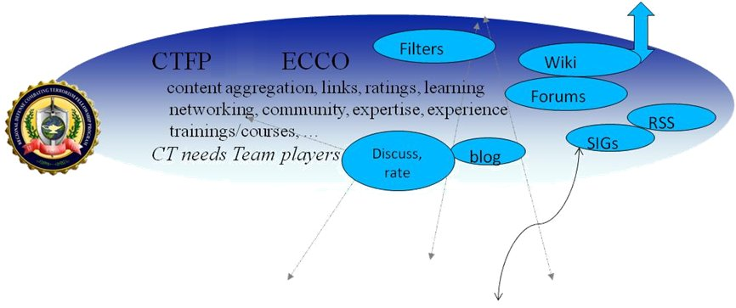
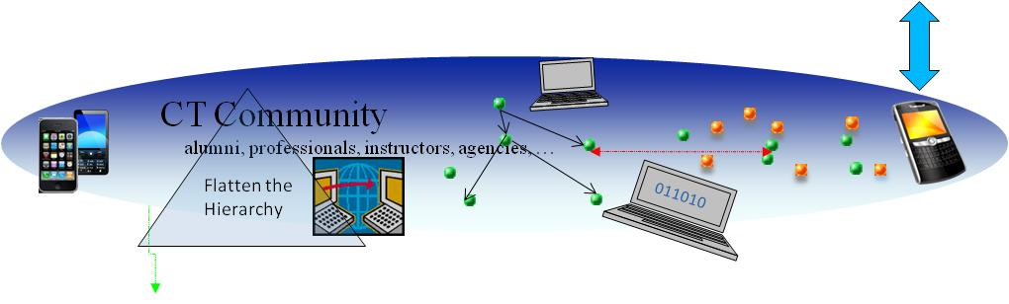


Aggregate and add meaning and meta-data to information/news/reports, connect people to actionable information, connect people to people… foster teamwork and empowerment.
Repositories, Libraries, Databases, Blogs, BBS's, Discussions, News-feeds(RSS), Websites, games, chats, Reports, articles, ...
Notes:
Aggregate and add meaning and meta-data to information/news/reports, connect people to actionable information (2-mode matrices), connect people to people (1-mode matrices) …
Terrorist networks: ad hoc, hidden, flexible, robust; successfully being used for propaganda, recruiting, finance, planning operations…

Slide 11
Two-Mode Affiliation Networks
Users may interact:
Directly
  -- contact via private messaging, comment on a blog or article authored by 2nd person. “Single-mode”, i.e. person ←→ person
  -- connection in Social Network is stronger, more immediate
Indirectly
  -- comment on the same article, a 3rd person’s blog, read same RSS feed story, contribute to same wiki article, …
  -- infer a connection, raw data is “affiliation”, person←→blog , person ←→ forum, …
  -- Analysis yields person ←→ person & affiliation-i ←→ affiliation-j
  -- Relationships identified among information types, sources, articles, books*, …
* e.g. Amazon book recommendations

Slide 12
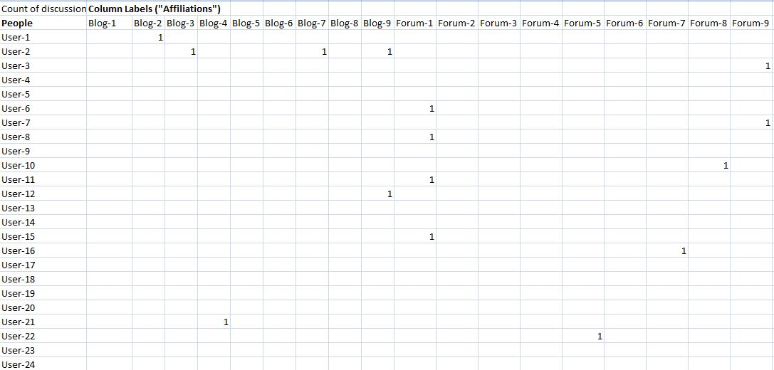
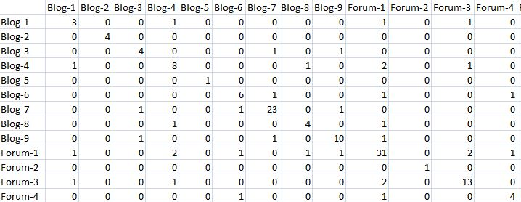
Two-Mode ➔ One-Mode
“Affiliation”, person ←→ blog , person ←→ forum, …
Visualize connections among site ‘content’
Visualize inferred connections among users
Notes:
Similarly for people ←→ people single mode connections. “Suggest” people to other people (Facebook, LinkedIn), and/or “Content/Affiliation” to people (Amazon books)

Slide 13
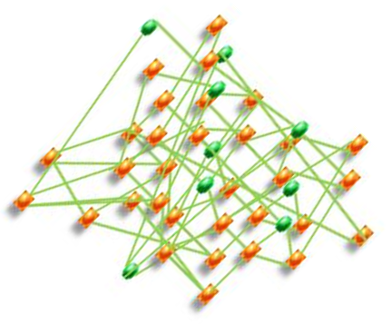
What is Optimal Connectivity?
To organize to fight a common enemy?
Can a network be too connected
  Or too disjoint?
Is there an optimal network connectivity (i.e. not just max or min)?
To share information (be ‘searchable’)
To promote useful emergent behavior

Slide 14
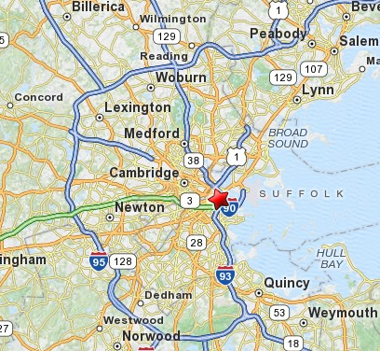
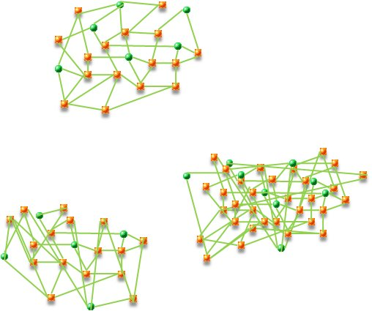
Can a “Community” be too disjoint?
Can a group of people be too disjoint and cliquish
  -- to heed important warnings
  -- to enable responsive and effective emergent behavior
  -- to self-organize against a common enemy
An influential 1973 study* shows exactly that:
  -- Boston’s West End Community** was too cliquish, forming highly disjoint sub-networks
  -- Failed to organize against Boston’s “urban renewal”
  ➔ was eventually destroyed
* Mark Granovetter, 1973 American Journal of Sociology
** “… widely known because a late 1950s urban renewal project razed” neighborhoods to redevelop the area.” -- Wikipedia
Notes:
“The area is widely known because a late 1950s urban renewal project razed a large Italian and Jewish neighborhood to redevelop the area.” -- Wikipedia

Slide 15
The Strength of “Bridging Links”
In contrast to the West End Community
A neighboring Boston community:
  Had numerous “bridging links”
  Enabled effective organization for defense
  Successfully withstood the threat
  Survived as a viable community
Notes:
There are other studies on embedded links and survival of organizations

Slide 16
Fast-forward to the Global CT challenge of today
Granovetter study suggests important questions
A global context, with “neighborhoods” of CT professionals
  Diverse languages, cultures, professions, talents, organizations
How to measure current state of cohesiveness of global CT community?
How to encourage bridging links and cohesiveness to enable effective learning & self-organization?
➔ thus materially increasing capacity-building CT partnerships!

Slide 17
Social Network Analysis
Concepts:
  “Centrality” (betweenness, degree, …)
  Influence
  Searchable networks
  Reach
Model site activity, Analyze & Visualize
“feedback loop”? To optimize (what MOE’s?)
ECCO Site
SNA
Tuner

Slide 18

Social Media Websites
Goals
  Not optimizing page views
  Not “monetizing” traffic, nor selling Google Ads!
  MOE’s
    Usability
    Site engagement, stickiness, page views,
    Interactions among nations, organizations, individuals, races, cultures, …
Techniques
  ‘Social Equity’, reputation, recognition
  Users contribute content
  Users interact directly & indirectly
Notes:
May interact indirectly through the information content they and others contribute. “connect people to information, may mediate connecting people to other people” ebr

Slide 19
Closing the SNA Loop
Website architecture & parameters
Site metrics
Soc. Net Structure
MOPs, MOEs
Server logs
MySQL tables
Visual Analytics
Exploratory Data Analysis
SNA Interpretation
Longitudinal Studies
Emergent Behavior?
Optimize SNA Model
By tuning
site Decision Var’s
CT MOEs
Continuing engagement
Capacity building
Collaboration
Tune the website, spiral development

Slide 20
In-class Networks ➔ Online (& bridges)
Max. “Influencers” in Network
Network Searchability
Number of Bridges
Edge betweenness
(Venture Capital Network)
Notes:
“The strength of weak Links” (bridging links). Identify Network topography SNA metrics, as well as “influencers”, “bridgers”, brokers of information, …

Slide 21
Thank You!
Questions?
Comments?
"Judge a man by his questions rather than by his answers"
-- Voltaire

Slide 22
Backup slides, materials
Longitudinal Study of Venture Capital Network

Slide 23
Longitudinal Studies
Time evolution of networks
Feedback to site architecture
“time scales”
  For on-site networks to evolve
  For feeding back onsite behavior/analyses to site architecture
  For users to respond to changes
  Identify “emergent behavior”
Overall MOE’s for “continuing engagement”…
Notes:
Organic, agile response to actual website activities. Feedback changes to promote desired behaviors, aided by SNA insights and metrics.

Slide 24

CTFP: Combating Terrorism Fellowship Program
Short- and long-term Combating Terrorism programs for international students at 5 schoolhouses and 6 regional centers around the world.

Slide 25
What kinds of usage data?
Build:
  effective collaboration,
  knowledge & data -filtering, -ranking, and -fusion.
  supportive professional learning networks
  social structures (nets) through computer-mediated interactions?
Website features:
  wiki, messaging, user-ratings, and Forums, personalization
  generate that data help us learn how to foster effective CT collaboration and learning community online.

Slide 26

CTFP ECCO Project
Needs, Gaps, Solutions
Needs
Gaps
Build and strengthen a global network of CT experts and practitioners committed to supporting US efforts against terrorists and their organizations
Limited reach to international CT experts and practitioners, and
Limited, short-term and intermittent meaningful contact and collaboration using traditional means
Solutions
“The worldwide CT network does
exist! And all this thanks to you!”
--CISA Romanian Alumnus
Establish and sustain a global network of CT experts and practitioners using a web-delivered knowledge management and collaboration platform that will significantly extend our reach to international communities and support sustained global CT partnerships
Create the networks that fight the networks

Slide 27
CTFP Education, Collaboration Community Online Project
Addressing the Gaps
Extending the Reach
Legitimate Environment
We can reach any CT practitioner with an internet connection, anywhere in the world
CTFP has created a legitimate environment for international CT collaboration with courses and outreach
We extend this environment where international exchange can take place without raising red flags
Keeping Connected
Global on-demand, long-term and sustained meaningful contact using social media web tools through online knowledge sharing, collaboration, training and education
Proven Technologies
Accepted, established and matured in large private corporations and government agencies (e.g., State Department, WhiteHouse.gov)
Social media web technologies are high leverage force multiplier tools for global connectivity

Slide 28
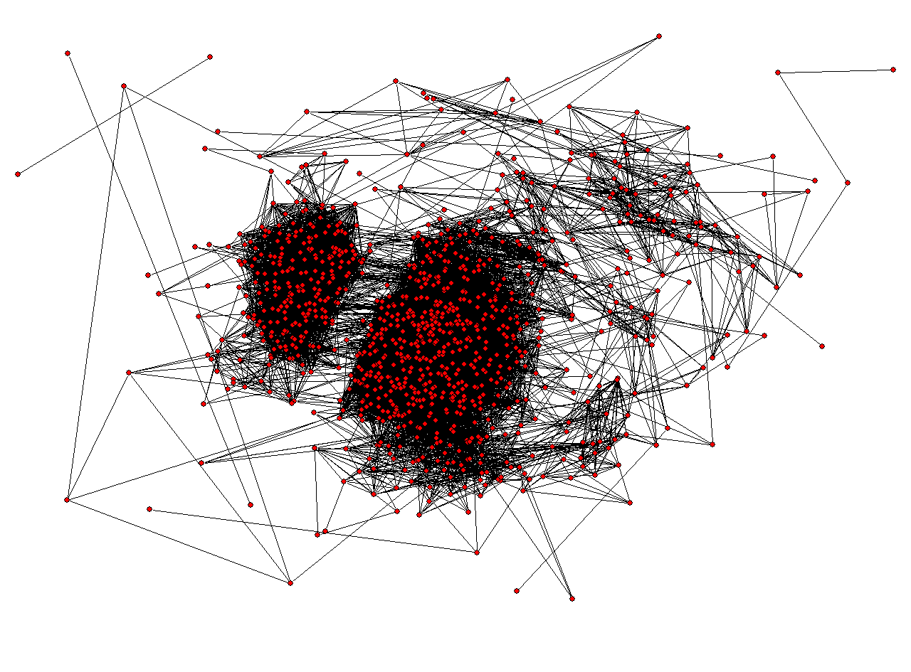
Dynamic Network Processes
Key Analysis Data:
Group formation and dissolution
Opinion consolidation, polarization
In-group vs. inter-group connectivity
Presence of bridging ties and groups
Hierarchy vs. global reachability
Foster efficient teamwork, information sharing and knowledge fusion, link together individuals, groups with interests, expertise, information:
➔ effectively solve shared problems.
Visualization of large interaction network in Pajek

Slide 29
Talking Points for MOEs

Slide 30
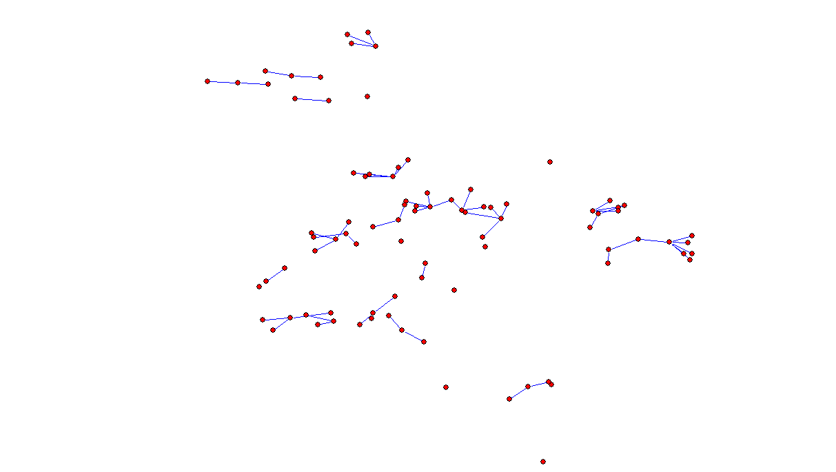
Venture Capital Network

Slide 31
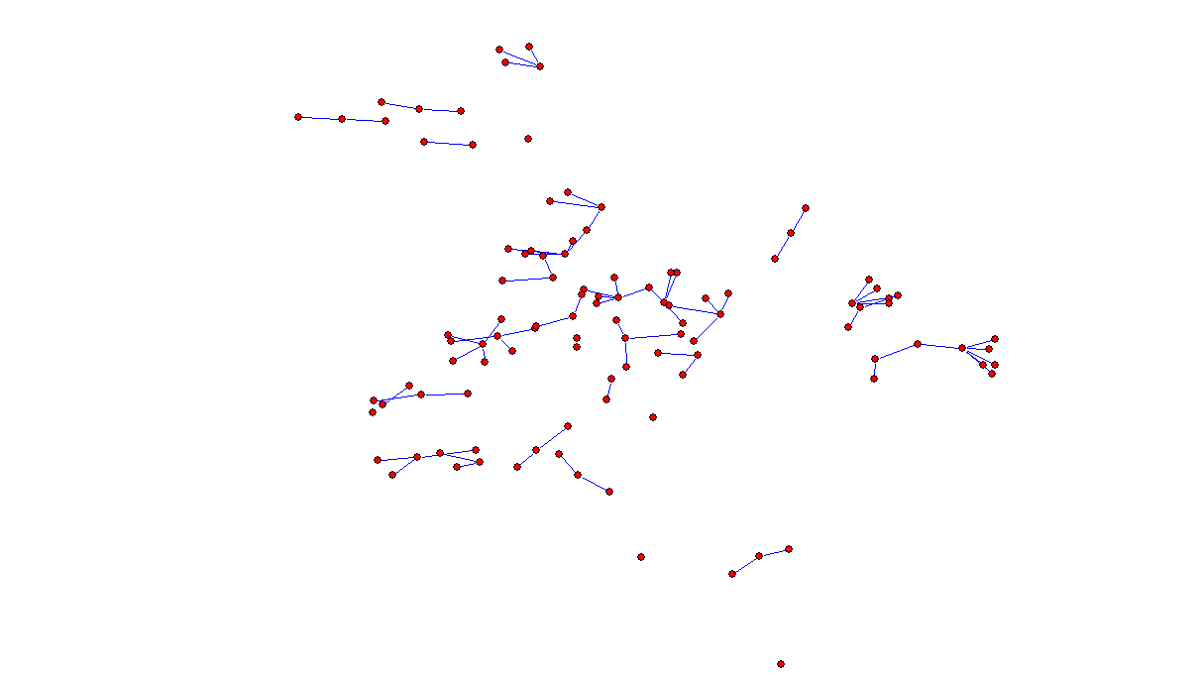

Slide 32
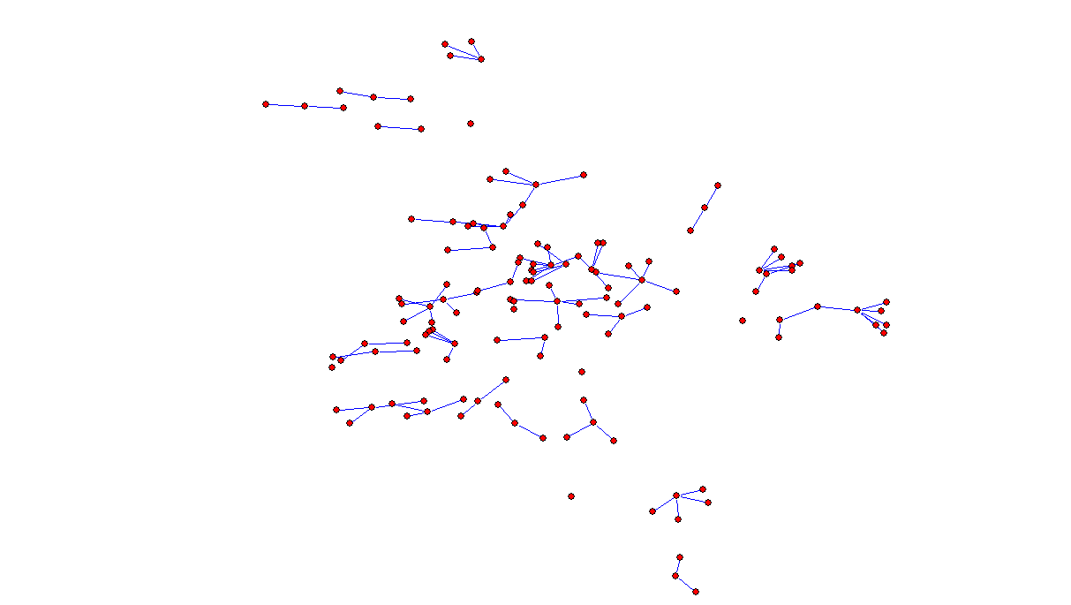

Slide 33
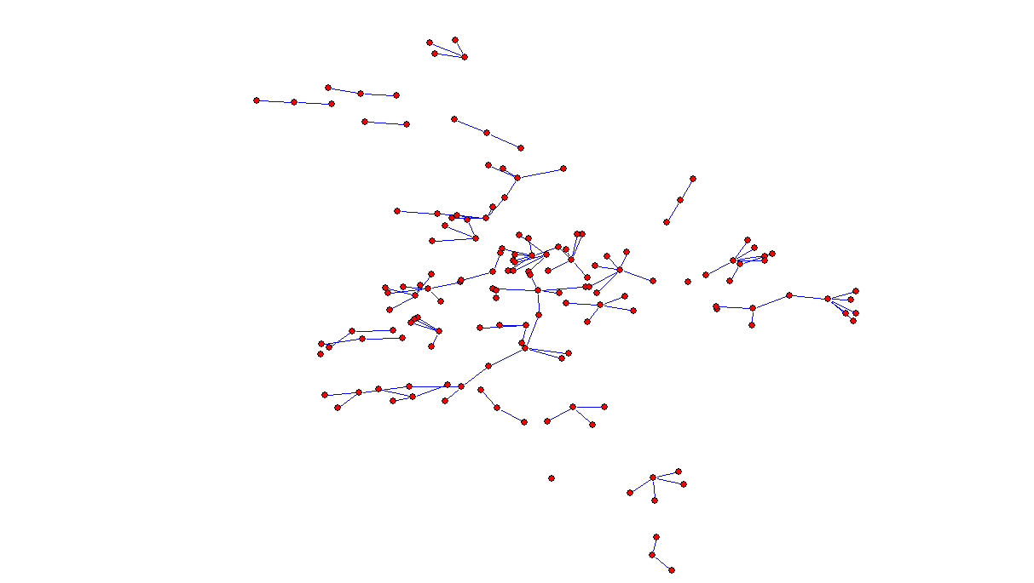

Slide 34
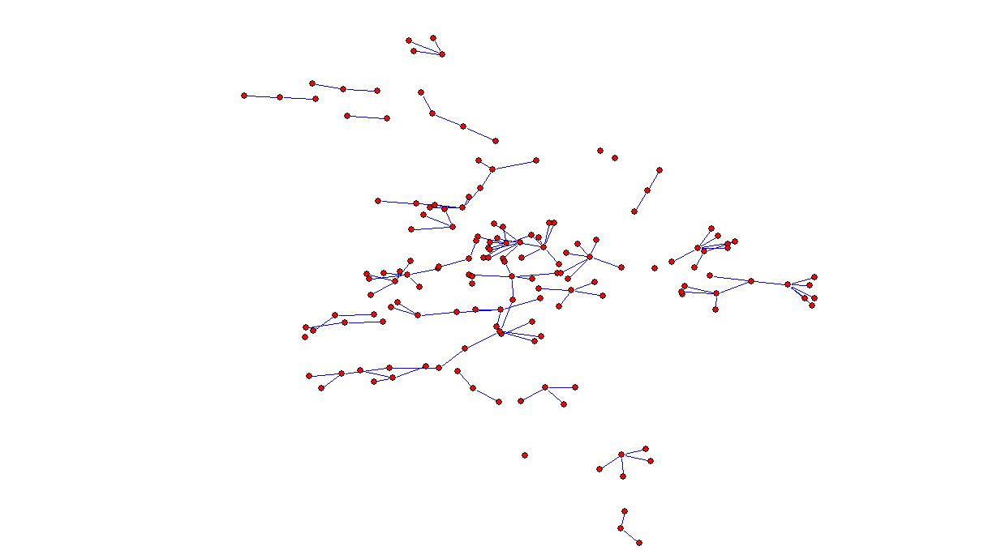

Slide 35
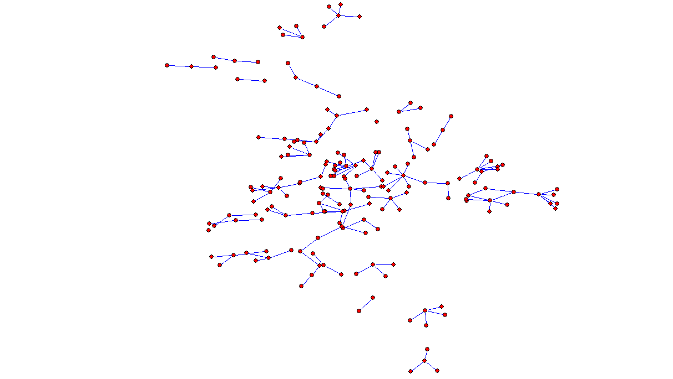

Slide 36
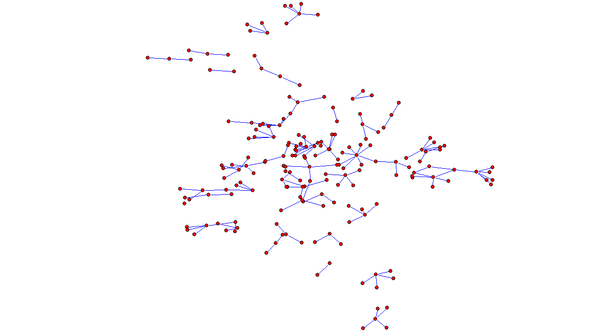

Slide 37
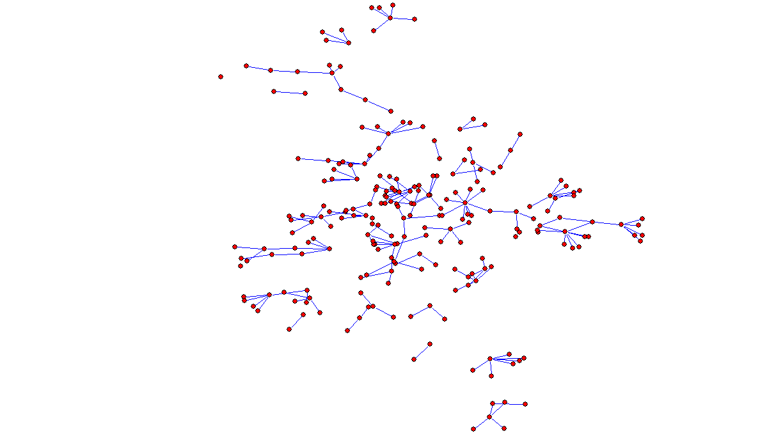

Slide 38
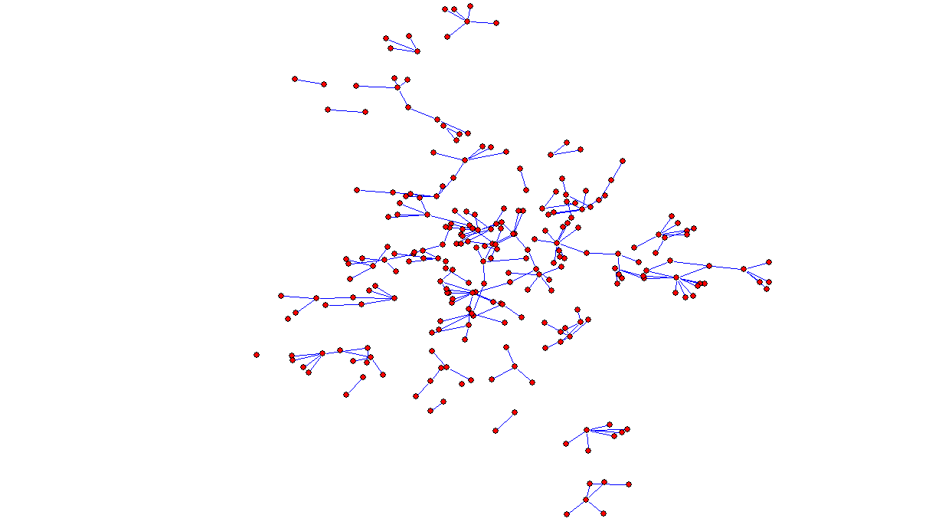

Slide 39
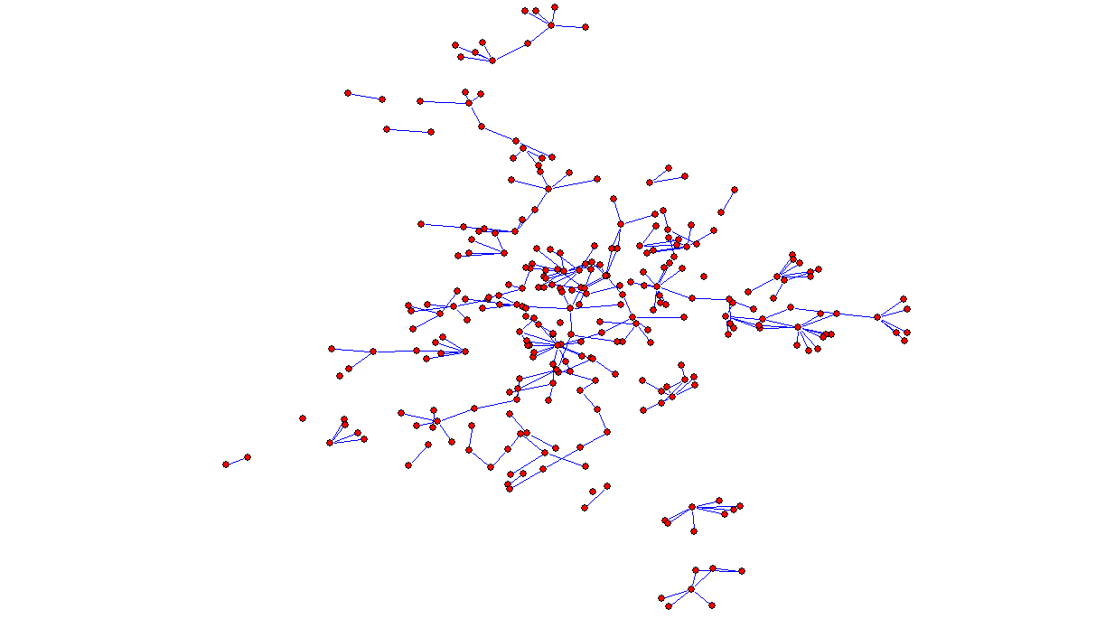

Slide 40
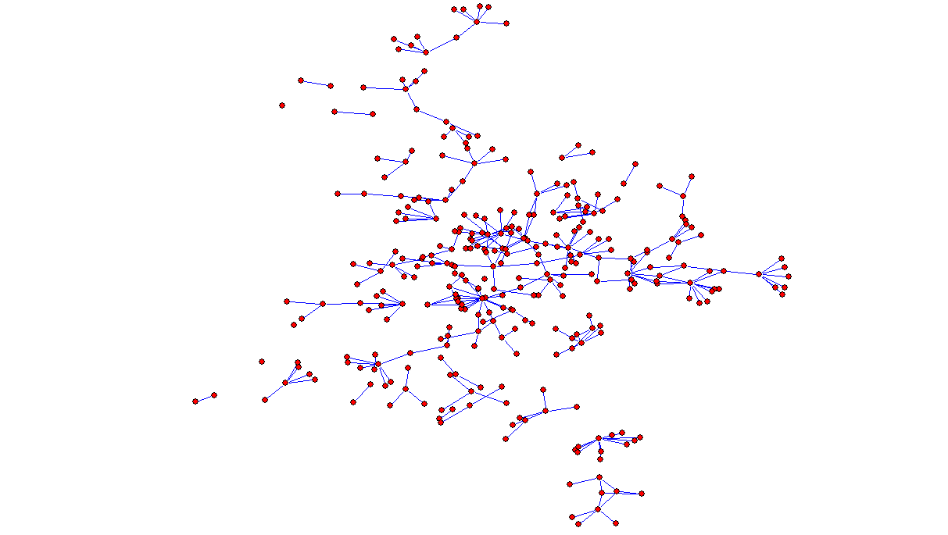

Slide 41
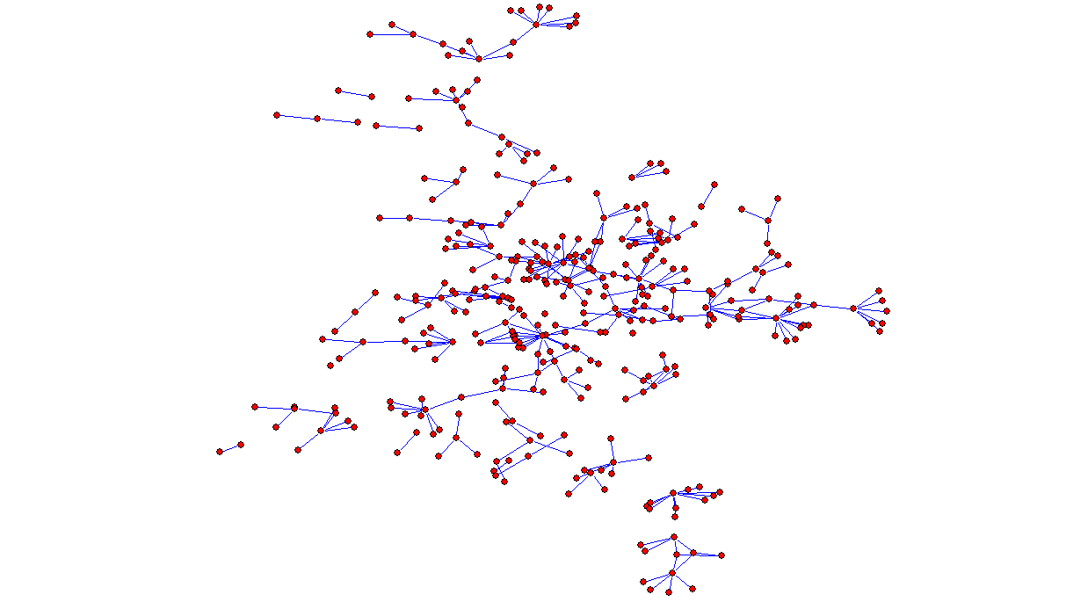

Slide 42
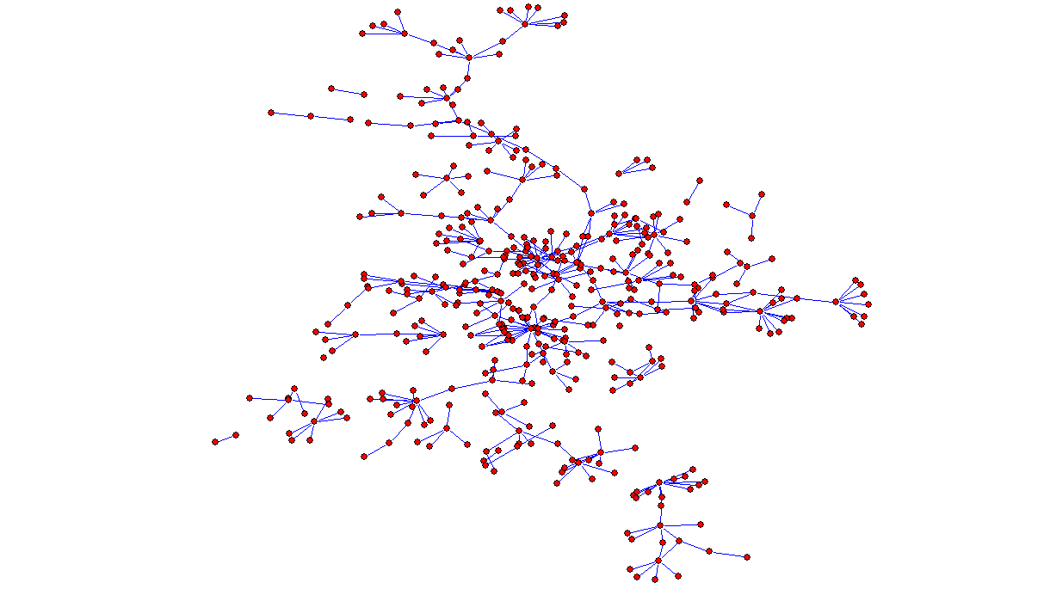

Slide 43
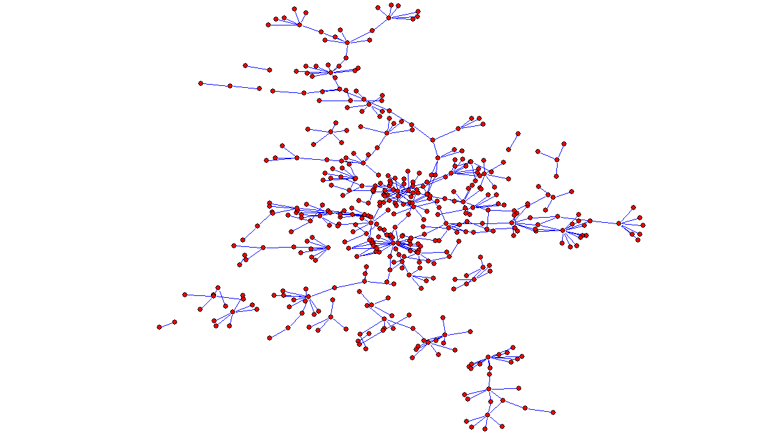

Slide 44
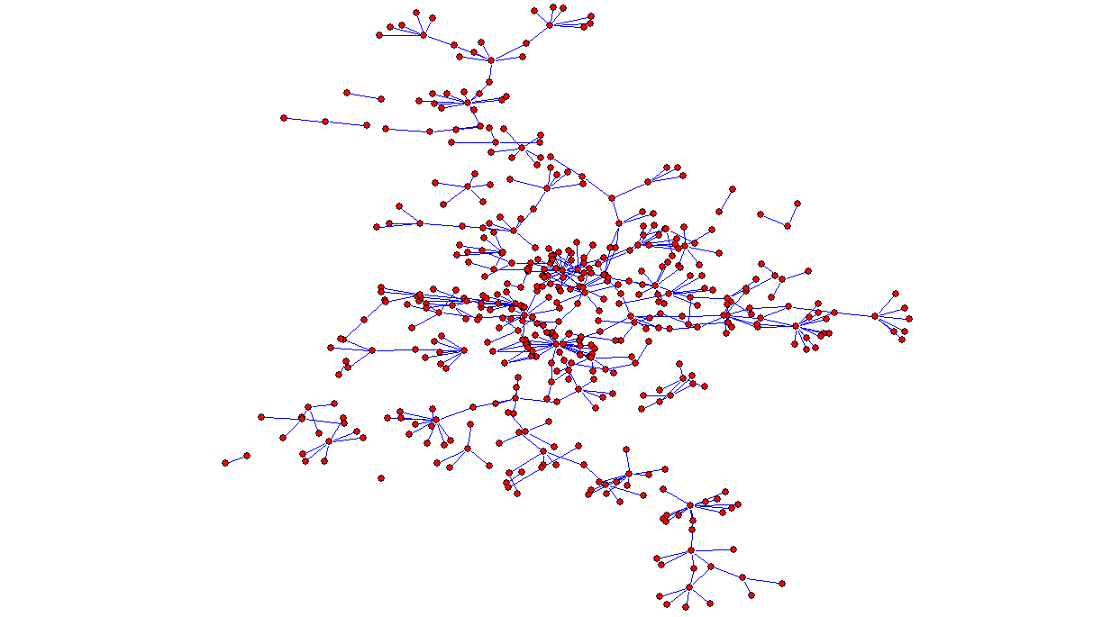

Slide 45
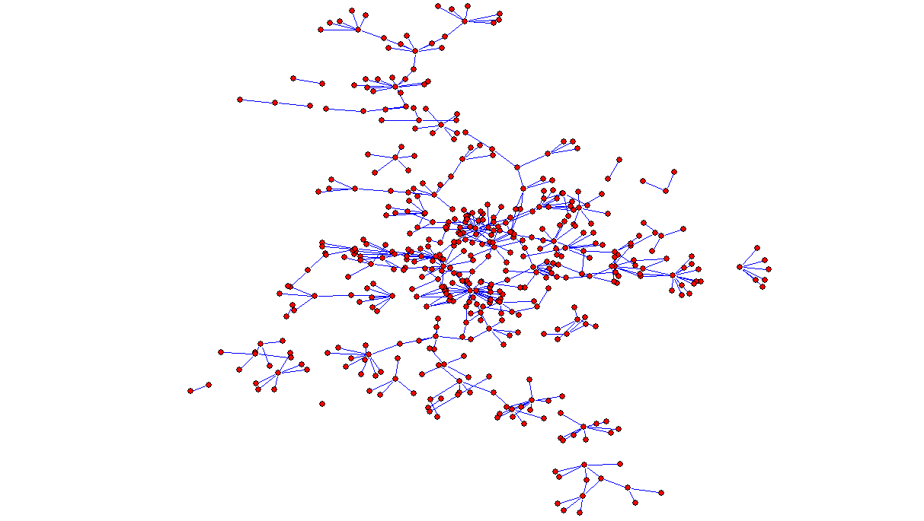

Slide 46
